Slide 1

Vacation Tracker Application
Track your vacations with ease!

Slide 2

Created by
Asmaa Shehata ALX -Track Software Engineering -C16

Slide 3
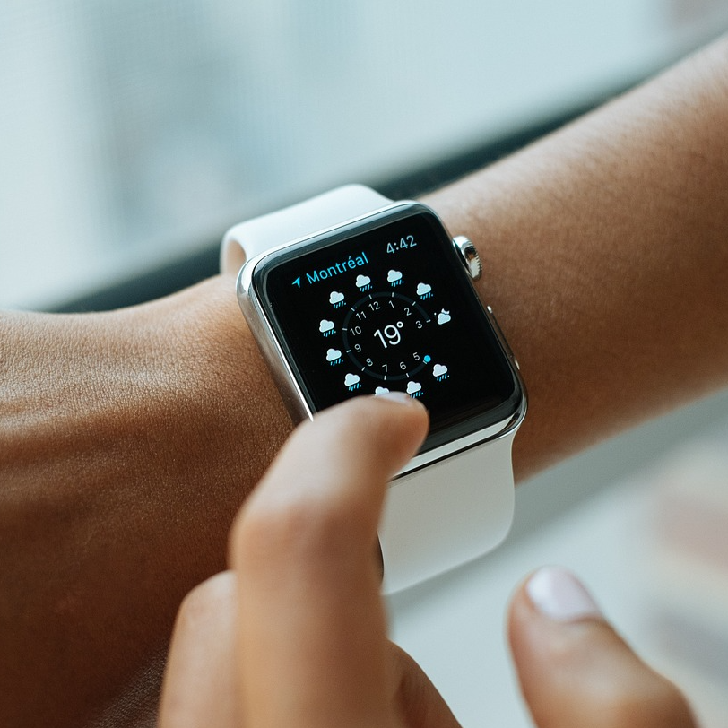
Utilizing email to track employee vacations frequently leads to confusion, errors, and operational inefficiencies, disrupting workflow and decreasing employee satisfaction. This is precisely why we've developed the Vacation Tracker web application, empowering employees to effortlessly monitor their vacation time.

Slide 4

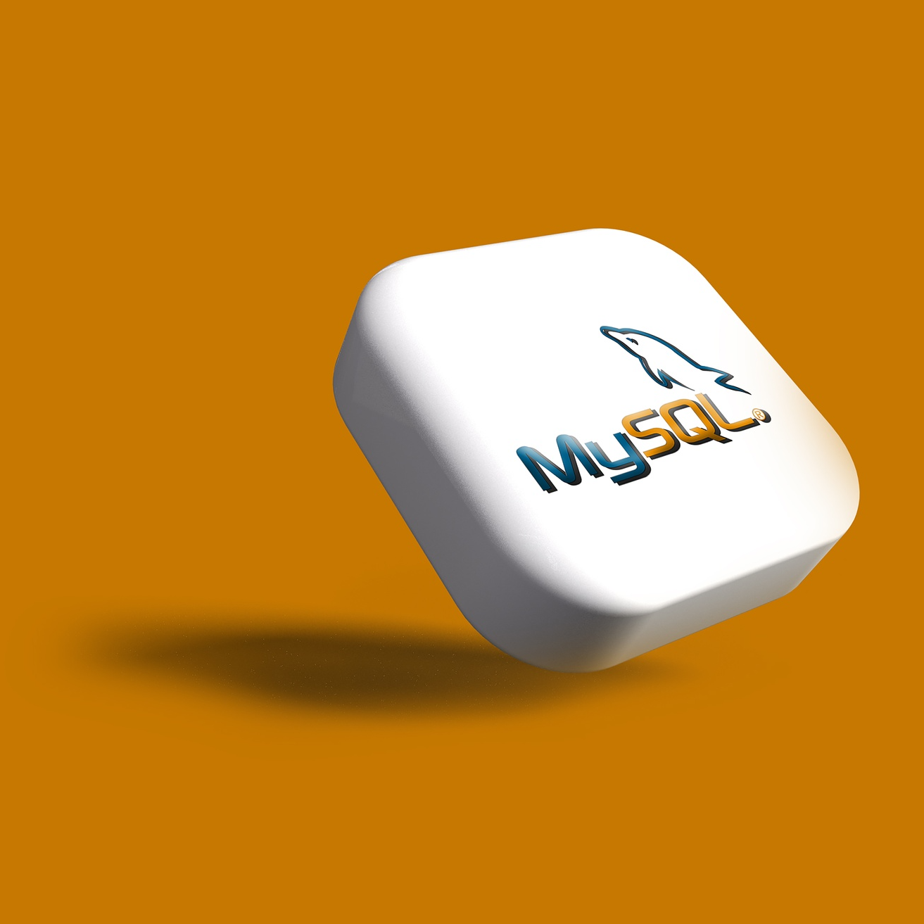

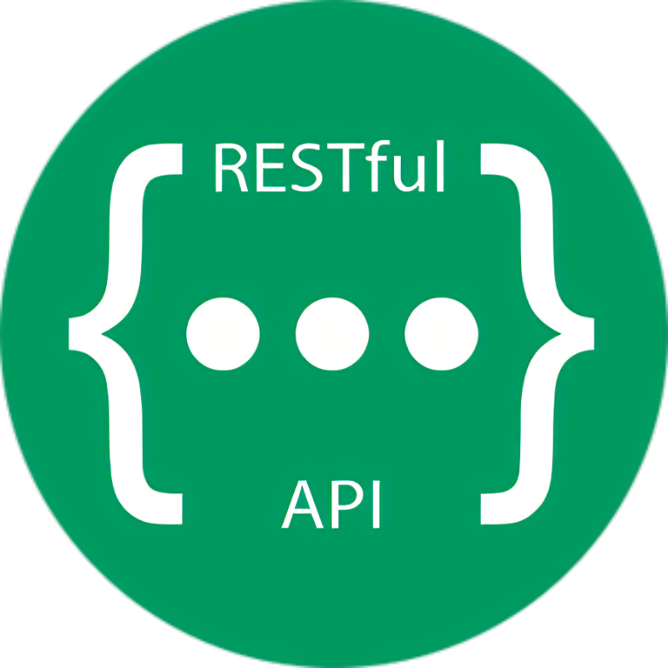
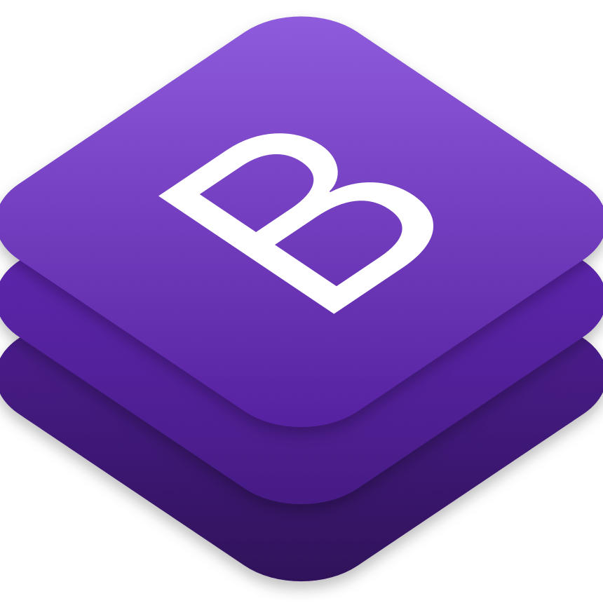
Technology & Architecture
Backend
Data Base
Flask Web Frame work
RESTFUL Api
Frontend: Bootstrap

Slide 5
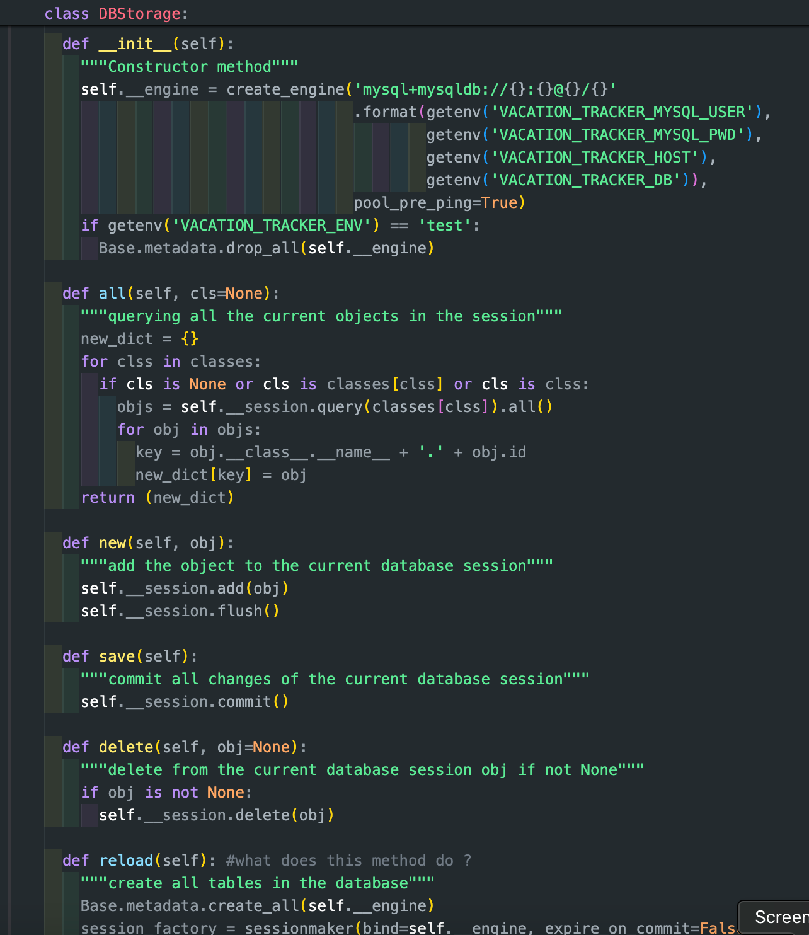
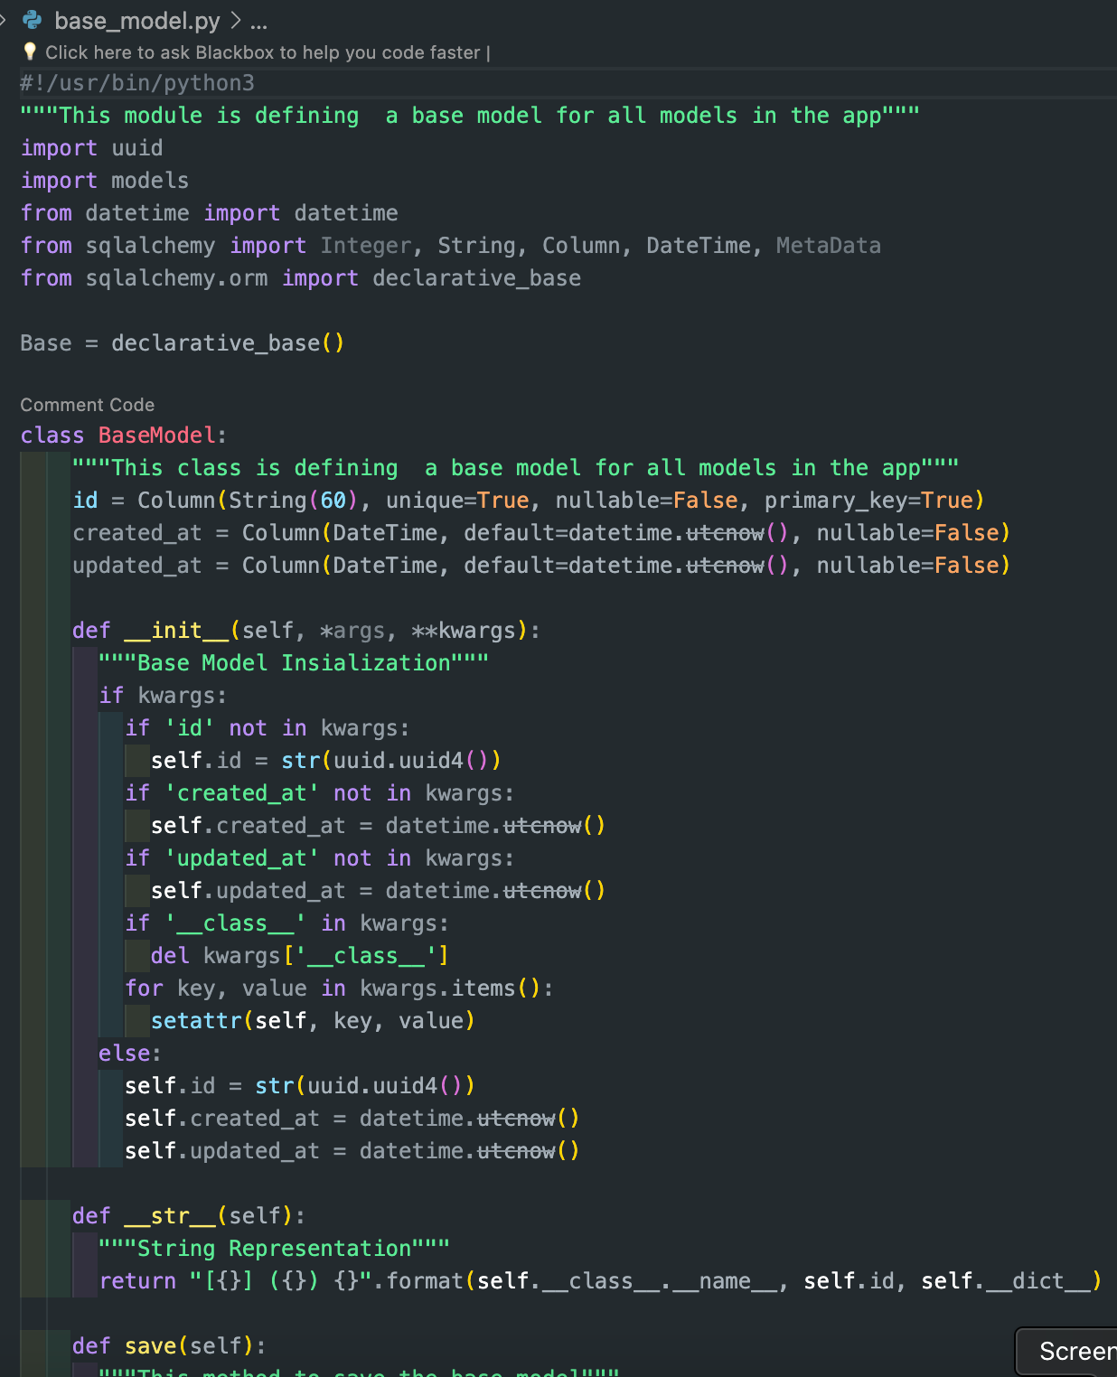
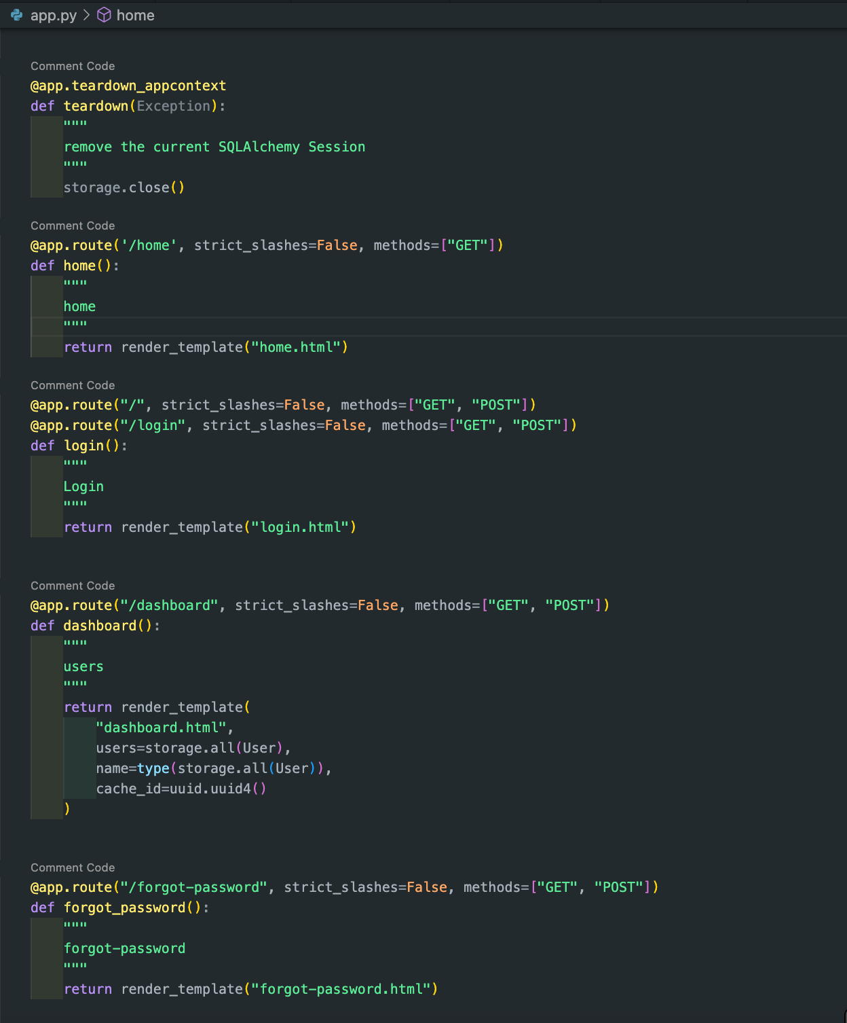
Code Snippets
DB storage. BaseModel
app.py

Slide 6
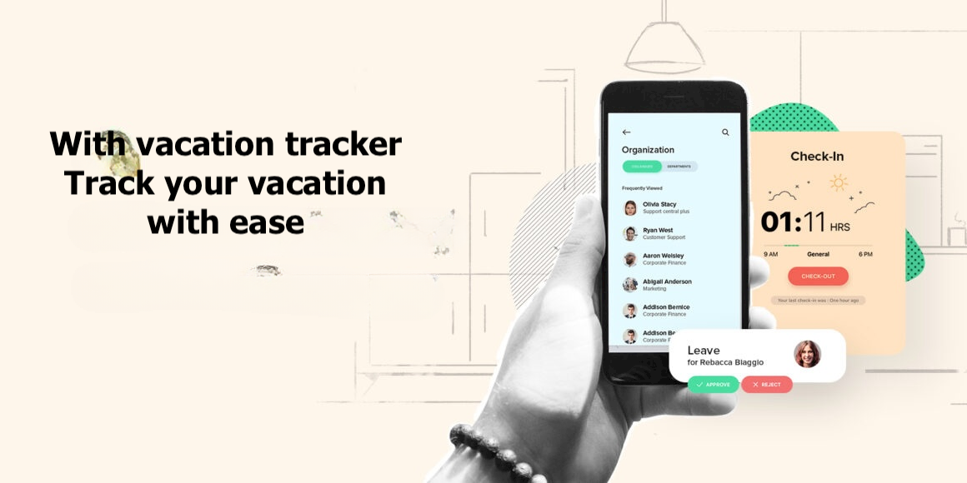
Benefits of the vacation tracker application
Streamlined Process: The app automates and centralizes the vacation request process, eliminating the need for manual paperwork or email chains. This streamlines operations and saves time for both employees and managers.
Reduced Errors: By standardizing the vacation request process and eliminating manual data entry, the app reduces the risk of errors such as double bookings or incorrect vacation balances.
Improved Communication: The app facilitates transparent communication between employees and managers regarding vacation requests. Real-time updates and notifications ensure that all parties are informed of the status of requests.

Slide 7


Slide 8

Thank you for your valuable time!

